Slide 1
OBJECT DETECTION WITH VOICE FEEDBACK
N180197 - T.LEELAVATHI

Slide 2
Abstract
Object Detection is a field of Computer Vision that detects instances of semantic objects in images/videos (by creating bounding boxes around them in our case). We can then convert the annotated text into voice responses and give the basic positions of the objects in the person/camera's view. In this object detection with voice feedback project , we propose a system that combines real-time object detection using the YOLO algorithm with audio feedback to assist visually impaired individuals in locating and identifying objects in their surroundings.The object detection with voice feedback project proposes a system that will detect every possible day to day multiple objects on the other hand prompt a voice to alert person about the near as well as farthest objects around them.To get the audio Feedback gTTS (Google Text to Speech), python library used to convert statements into audio speech.

Slide 3
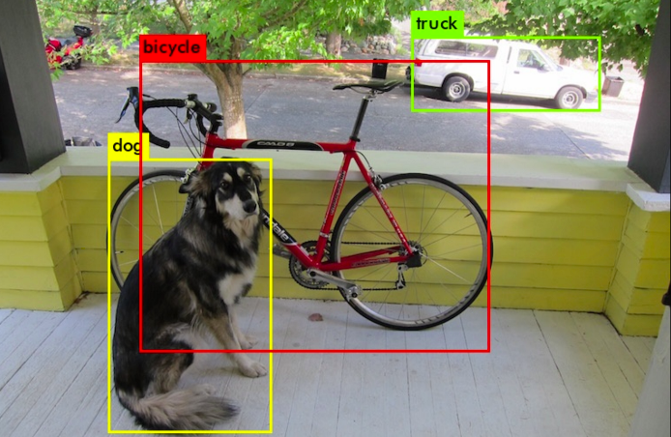
Introduction
The application developed can detect the objects in people surroundings. The object detection with voice feedback model has been proposed which makes the use of smartphone, a common device available to anyone and used technology to make an application which can help the blind user detect objects in his surroundings and help him in navigating from one place to another.
The aim of the project is an object recognition function with mobile application should be able to to detect certain objects from the camera and return audio output to announce what it is. In order to recognize object, machine learning ha to be involved.

Slide 4
Motivation for the Work
Enhancing Independence:
Visually impaired individuals often face challenges in navigating and interacting with their environment. By providing real-time object detection and audio feedback, this system can enable them to independently identify and locate objects, promoting a higher level of self-sufficiency in their daily lives.
Safety and Mobility:
Accurate object detection combined with voice feedback can contribute to safer navigation. Users can be alerted to obstacles, hazardous objects, or changes in their surroundings, thereby reducing the risk of accidents.The system's real-time capabilities enable it to detect changes in the environment, such as moving vehicles or sudden construction zones.

Slide 5
Motivation for the Work
Access to Information:
Visual impairment can result in limited access to visual information, making it difficult to perform tasks such as identifying products, locating items, or understanding one's surroundings. By converting visual information into auditory cues, this system ensures that crucial information is accessible to visually impaired individuals.
Daily Task Facilitation:
Simple daily tasks, such as identifying items, finding objects, or navigating unfamiliar spaces, can be challenging for visually impaired individuals. This project seeks to make these tasks easier and more manageable, ultimately improving their overall quality of life.

Slide 6
Real World Applications
Public Transportation:
The integration of real-time object detection with audio feedback in public transportation enables visually impaired individuals to independently and confidently navigate bus stops, train platforms, and subway entrances, providing them with essential information about their surroundings, vehicle identification, route details, and seat availability.
Home Environment:
The system can assist users in locating household items, finding furniture, and navigating around their homes, enhancing their independence and comfort. This technology enhances their daily lives, ensuring a more seamless and confident experience within their living spaces.

Slide 7
Real World Applications
Tourism and Travel:
Tourists exploring new cities can benefit from spoken descriptions of landmarks, attractions, and points of interest, enhancing their travel experience.This immersive experience empowers travelers to independently learn about their surroundings, fostering cultural appreciation, engagement, and a deeper connection with the destinations they visit.
Emergency Alerts:
The technology can provide immediate voice alerts in emergency situations, enhancing public safety and information dissemination.

Slide 8
Research Gaps Identified
Real-Time Contextual Descriptions:
While object detection provides object names, there's a research gap in generating more detailed and contextual descriptions that convey the object's spatial relationships, colors, textures, and other relevant attributes to enhance the blind user's understanding.
Feedback Confidence and Accuracy:
While object detection provides results, blind users might benefit from knowing how confident the system is in its identification. Conveying this confidence level can enhance the user's trust in the technology and help them make more informed decisions.

Slide 9
Research Gaps Identified
Dynamic Environment Adaptation:
Dynamic environments, characterized by moving objects, changing layouts, and varying lighting conditions, pose challenges to consistent and accurate object detection and feedback. Developing strategies to handle these dynamic factors is essential to ensure the reliability and effectiveness of the technology.
User Interaction Customization:
Exploring ways to allow blind users to personalize the voice feedback system according to their preferences and familiarity can greatly enhance engagement, usability, and integration into daily life.

Slide 10
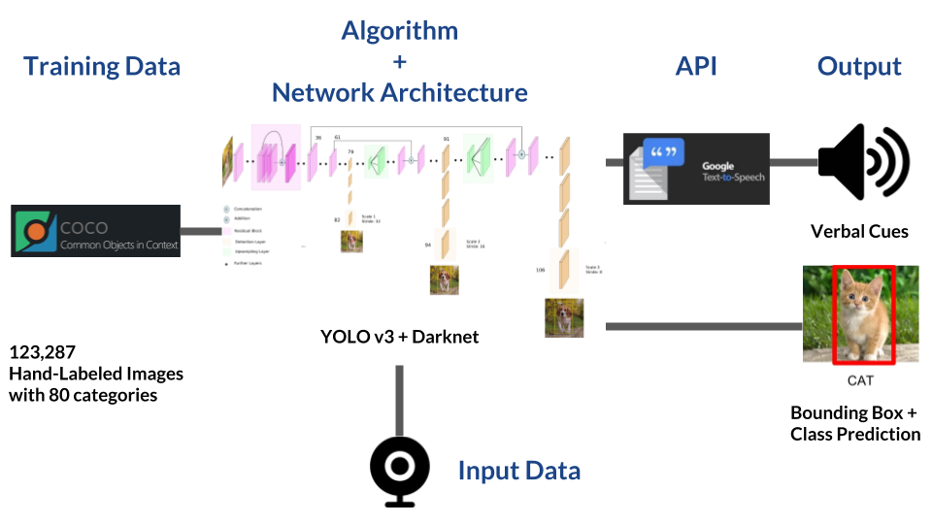
Proposed Method

Slide 11
Proposed Method
Capture Video Frames: Use a camera to capture real-time video frames.
Apply Object Detection: Utilize the YOLO algorithm to identify objects within the frames.
Convert Labels to Speech: Translate object labels into spoken text using gTTS (Google Text-to-Speech).
Generate Audio Feedback: Create an audio segment describing the detected objects using the converted text.
Customize Feedback: Allow users to personalize the voice feedback system based on their preferences.

Slide 12
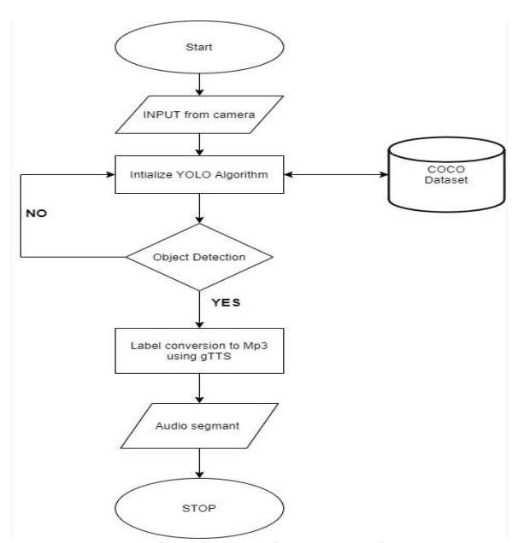
Flowchart

Slide 13
Starting Point:
The Start shape is the initial point from which the flowcharts steps and actions will follow.
Input from camera:
This step involves accessing the camera feed to capture individual frames. Process each captured frame as input for the object detection system.
COCO dataset:
COCO (Common Objects in Context) is a large-scale dataset containing images with objects in complex scenes.
It is used for evaluating and benchmarking object detection, instance segmentation, and other vision tasks.The dataset consists of a vast collection of images, each annotated with object labels, bounding box coordinates, and more.

Slide 14
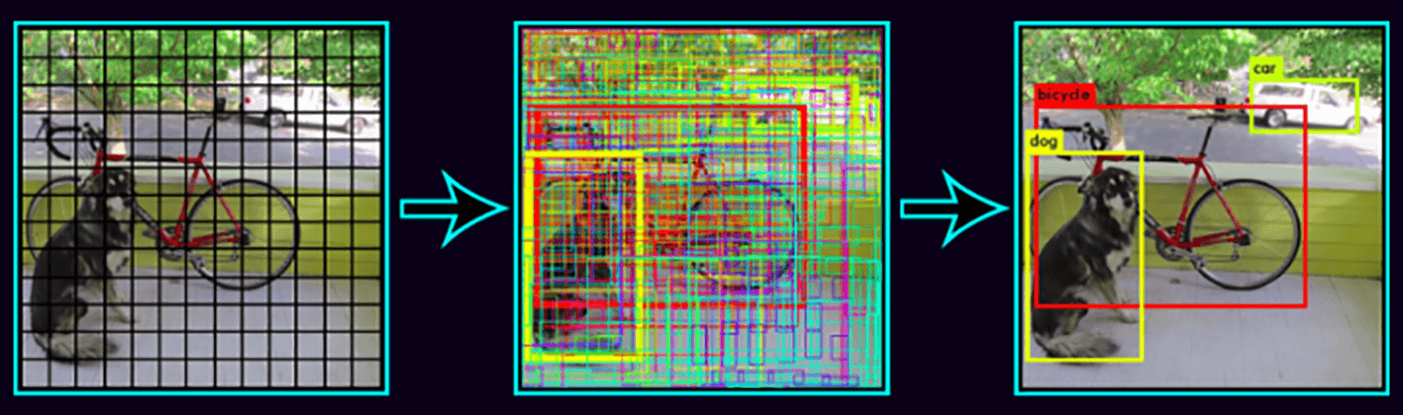
Initialize YOLO algorithm:
Set up and configure the pre-trained YOLO model for object detection.
Initializing the YOLO (You Only Look Once) algorithm involves setting up and configuring the pre-trained YOLO model to perform object detection on input images or frames from a camera.

Slide 15
Object Detection :
After initializing the YOLO algorithm, apply the model to the captured frames from the camera.
YOLO divides the input image into a grid and makes predictions for bounding boxes and class probabilities for objects within each grid cell.
img_height, img_width, _ = img.shape
width_ratio = img_width/width
height_ratio = img_height/height
The output of this step includes a list of detected objects along with their class labels and accurate bounding box coordinates.

Slide 16
Generate Audio Segment:
Use the converted text to generate an audio segment describing the detected objects.
Stop:
This step involves defining conditions or criteria that determine when the entire process should stop or come to an end, such as user input or reaching the end of the camera feed.

Slide 17
Experimental setup
Technologies/libraries used
Datasets
System Hardware
Results table/screenshots/any
Results comparison with other approaches

Slide 18
Technologies/libraries used
Programming Language:
Python version-3.11.0
Libraries:
OpenCV
Numpy
YOLO (Darknet or YOLOv3-TF)
gTTS (Google Text-to-Speech)
TensorFlow
Matplotlib
IO
Platform used:
Google Colab

Slide 19
Libraries
OpenCV: OpenCV (Open Source Computer Vision Library) is a widely used computer vision library that provides tools for image and video processing. It can be used for tasks like capturing video frames from a camera, preprocessing images, and visualizing the results of object detection.
NumPy: NumPy is a fundamental library for numerical computations in Python. It's often used for handling image data, mathematical operations, and data manipulation.
gTTS (Google Text-to-Speech): The gTTS library allows you to convert text into speech using Google's text-to-speech API. It's used to generate voice feedback based on the detected objects' labels and descriptions.

Slide 20
Libraries
Matplotlib: Matplotlib is a versatile and widely used visualization library in Python, allowing you to generate a variety of graphs and plots that vividly represent object detection results.
YOLO (Darknet or YOLOv4-TF): YOLOv4, for instance, can be implemented using Darknet or TensorFlow. YOLO is crucial for object detection, and the respective libraries provide pre-trained models and functions for object detection tasks.
IO: In Python, io stands for "input/output" and is a module that provides tools for working with input and output streams, such as reading from and writing to files, strings, and other data sources

Slide 21
System Requirements
Operating System : 64 bit windows
RAM : 4 GB(approx)
Disk : 320GB(approx)
Camera : Web Camera 10 Megapixels
Processor : Intel core I5

Slide 22
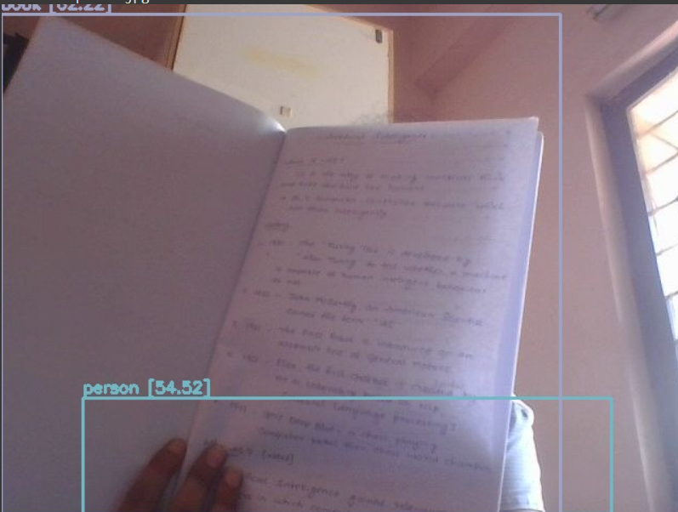
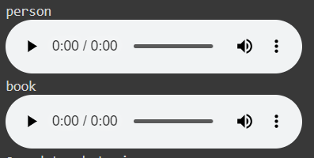
Results screenshots

Slide 23
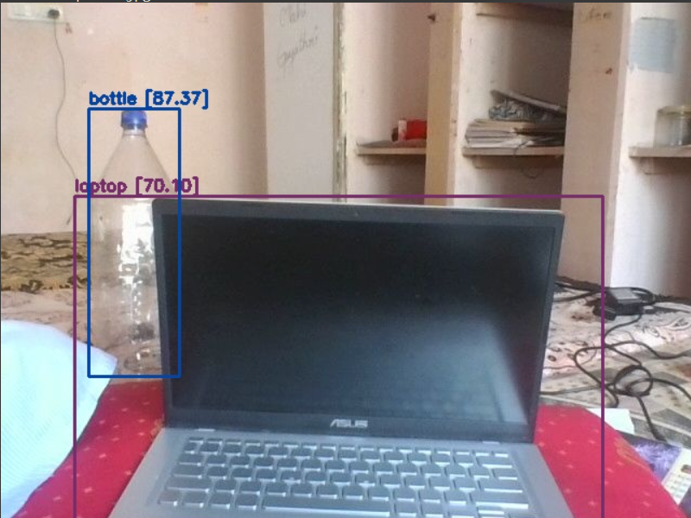
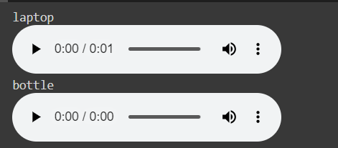
Results screenshots

Slide 24
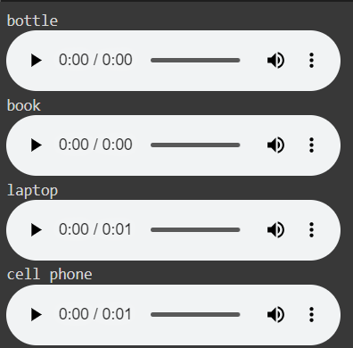
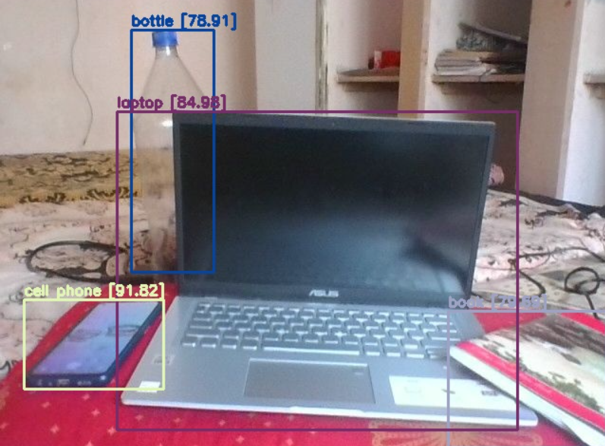
Results screenshots

Slide 25
Results comparison with other approaches
Faster R-CNN (Region Convolutional Neural Network):
Faster R-CNN provides high accuracy by using region proposal networks, making it suitable for precise object detection tasks. However, it might be slower compared to YOLO in real-time applications.
Drawbacks:
Complex Architecture: The intricate architecture of Faster R-CNN, including the region proposal network (RPN) and object detection network, can be daunting for beginners to comprehend, implement, and optimize.

Slide 26
Results comparison with other approaches
2. Haar Cascade Classifiers:
YOLO offers significantly higher accuracy and the ability to detect a broader range of object classes compared to Haar Cascade classifiers, making it a more robust and modern choice.
Drawbacks
Performance on Small Objects: Detecting small objects with Haar cascades might be challenging due to limitations in feature size and resolution.

Slide 27
Conclusion
The project of implementing object detection with voice feedback presents a dynamic and interactive solution that merges computer vision and audio synthesis technologies. This object detection with voice feedback project not only showcases the power of machine learning and computer vision but also highlights the potential for enhancing user experience through voice-based interactions.
For children, the system transforms learning into an interactive and engaging adventure, turning everyday objects into sources of discovery and knowledge. By hearing and seeing the objects around them, children can learn new words, explore their environment.By providing real-time descriptions of their surroundings, the system empowers blind individuals to navigate confidently and make informed decisions.This project serves as a dual-purpose solution: a playful learning companion for children and an empowering guide for the blind.

Slide 28
References
https://github.com/theAIGuysCode/YOLOv4-Cloud-Tutorial
https://ieeexplore.ieee.org/document/9377064
https://www.v7labs.com/blog/coco-dataset-guide

Slide 29
Thank You

